Slide 1
Project 4:
Predict West Nile Virus
Geh Si Rong, Lee Meng Chin, Teo Zhan Rui, Wee Zi Jian

Slide 2
TABLE OF CONTENTS
01
02
03
04
05
06
Problem Statement
Pre-Processing
Exploratory Data Analysis
Modelling
Cost Benefit Analysis
Conclusion / Recommendations

Slide 3
Problem Statement
The West Nile virus (WNV) is a mosquito-borne illness that can cause severe neurological disease and death in humans.
Since 2004, the Chicago Department of Public Health has increased surveillance and control efforts in a bid to prevent transmission of this virus.
Given weather, location, testing, and spraying data, our goal is to predict whether the WNV is present in a given location.
Based on our predictions, we will devise a cost effective strategy to deploy pesticides in WNV-hotspots.

Slide 4
Pre-Processing: Train / Test
Train: 10,506 rows, 12 columns (2007, 2009, 2011, 2013)
Test: 116,293 rows, 11 columns (2008, 2010, 2012, 2014)
Relevant columns:
Date
Species
Longitude
Latitude
WNV present
Set date as index
Assign nearest weather station to each trap
Group by mosquito species
Convert species to categorical features

Slide 5
Pre-Processing: Weather
2,944 rows, 22 columns
Daily data from May-October 2007-2014
Impute missing values (‘M’) and trace values (‘T’) with 0 or mean
Convert weather conditions (CodeSum) to categorical variables
Compute 14 day rolling average/sum of various weather data
Compute lagged (3, 5, 7, 10 days) versions of rolling weather data
Assign weather data to train/test data based on nearest weather station

Slide 6
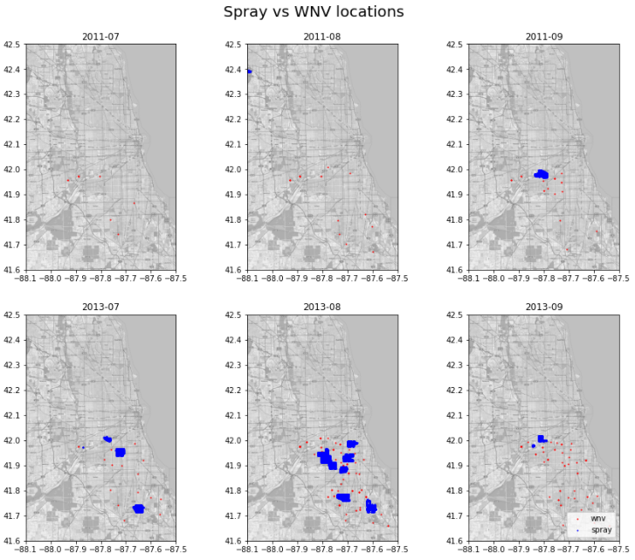
Pre-Processing: Spray
14,835 rows, 4 columns
2011 and 2013 spray locations and dates
Based on plots of sprayed locations vs WNV presence, spraying does not appear to reduce WNV presence in subsequent months
Notes:
Based on plots of sprayed locations vs WNV presence, spraying does not appear to reduce WNV presence in subsequent months

Slide 7
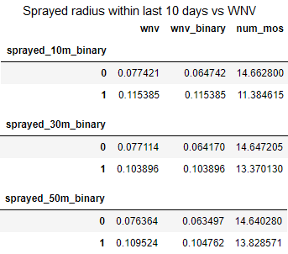
Pre-Processing: Spray
2011 and 2013 train data locations were checked if they had been sprayed within a certain radius within the past 10 days
Spraying within 10m, 30m and 50m of a location within the last 10 days has marginal effect on the number of mosquitoes caught or the presence of WNV
Since spray data for 2008, 2010, 2012 and 2014 is unavailable as well, spray data will not be used in modelling

Slide 8
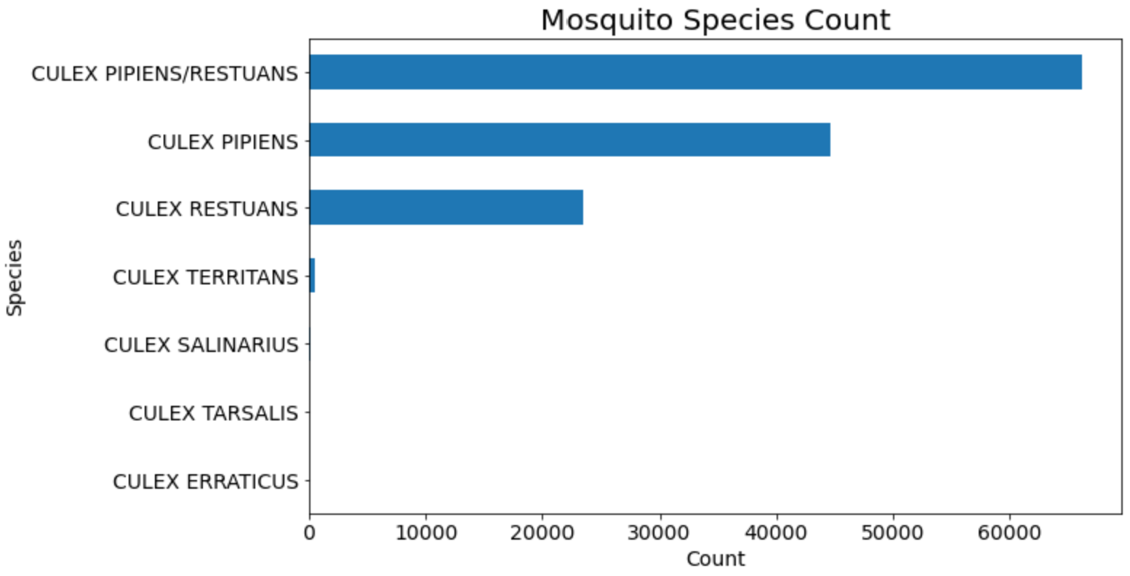
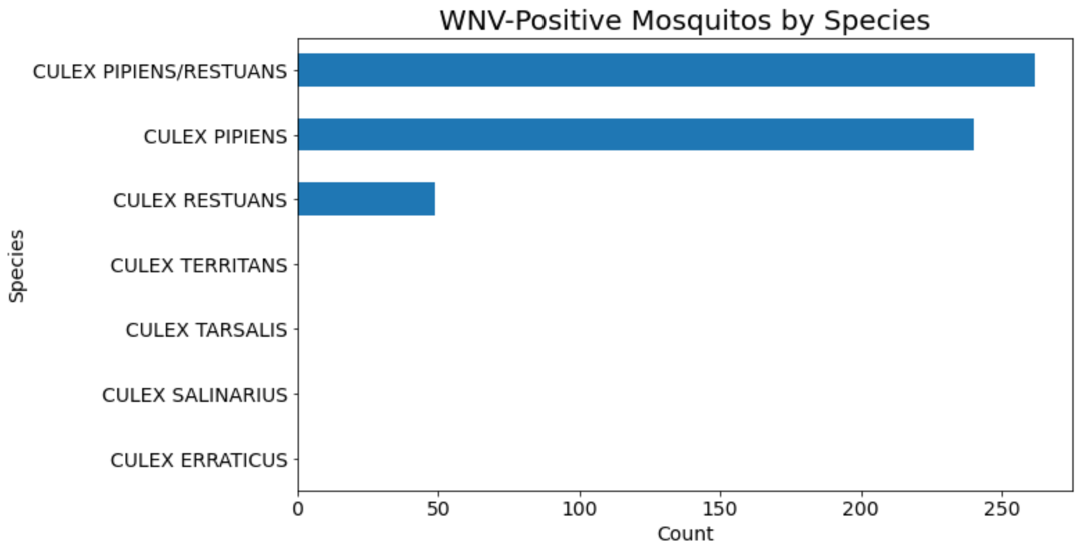
EDA: Mosquito Counts
Of the 7 species of mosquitoes caught, only 3 were found with the WNV. These were also the most frequently caught species
As the distributions of total mosquito counts and WNV-positive mosquito counts differ, we should expect species to be an important feature in predicting WNV

Slide 9
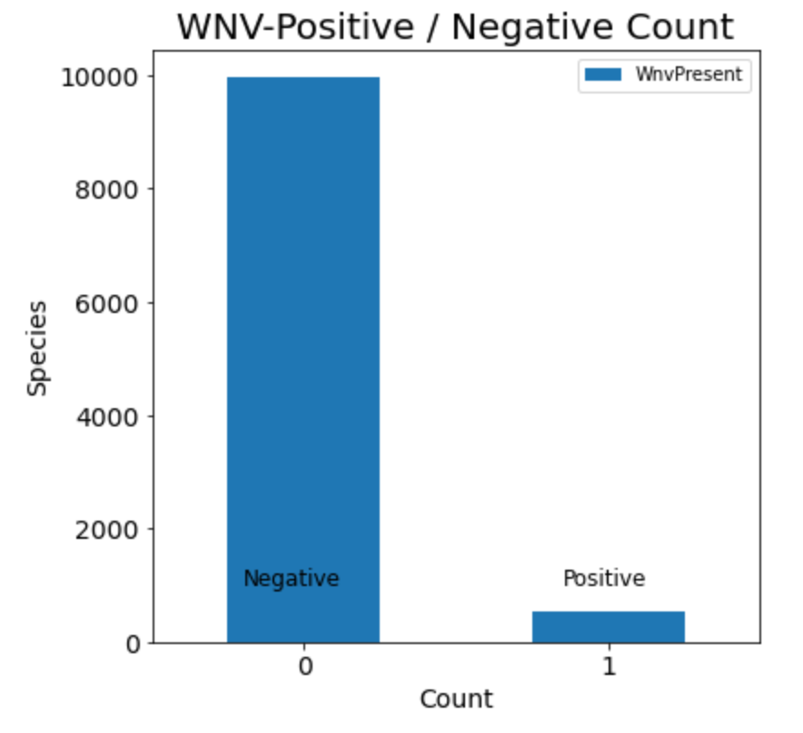
EDA: WNV Positive/ Negative Counts
Grouped by species, there are 9,955 WNV-negative vs 551 WNV-positive findings in the train data
As the classes are imbalanced, we resampled the WNV-positive data using SMOTE

Slide 10
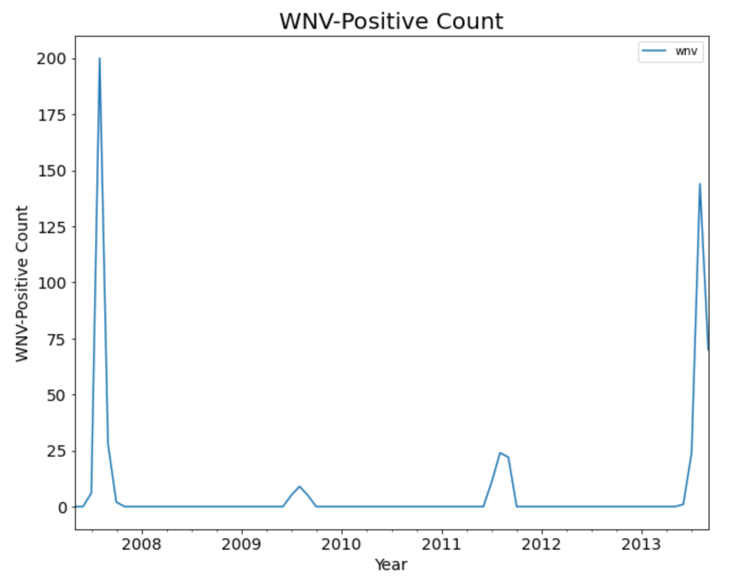
EDA: WNV-Positive by Date
WNV-positive mosquitoes were most frequently caught in August and September each year
2007 and 2013 had the most number of WNV-positive mosquitoes caught

Slide 11
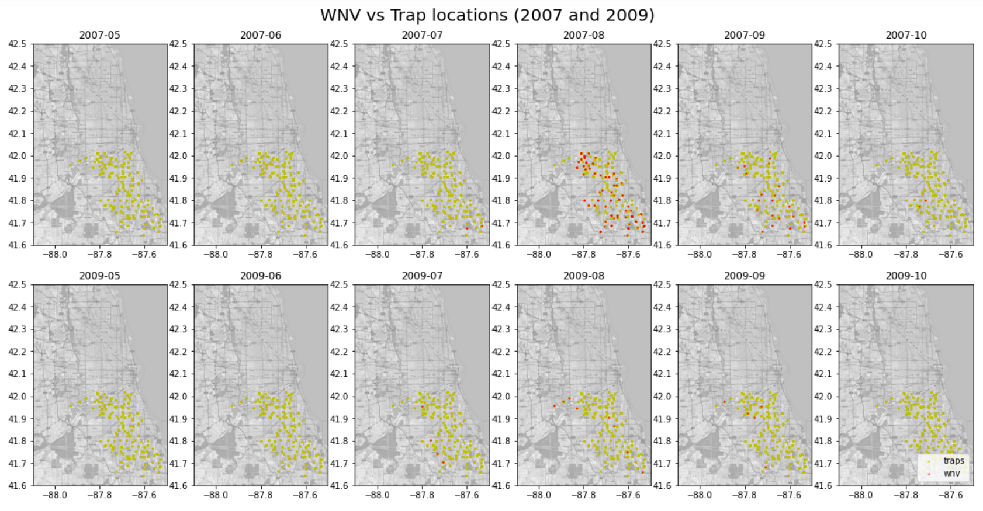
EDA: WNV-Positive by Location

Slide 12
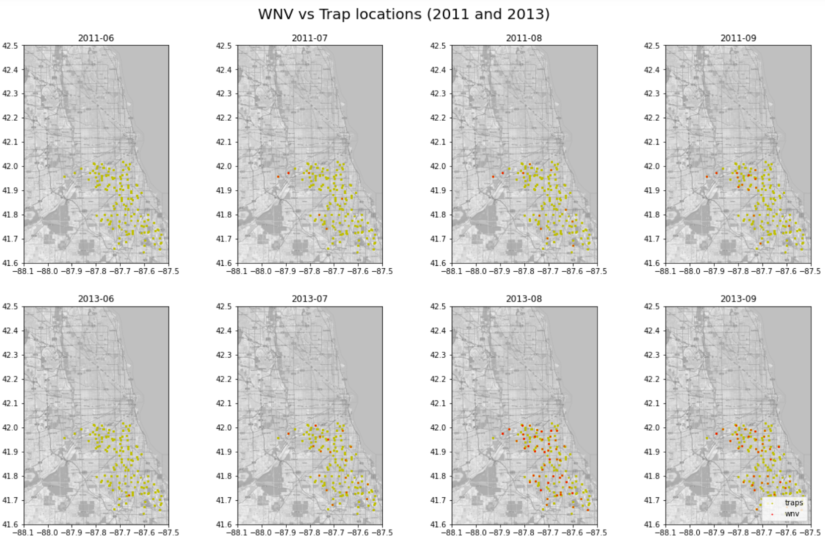
EDA: WNV-Positive by Location

Slide 13
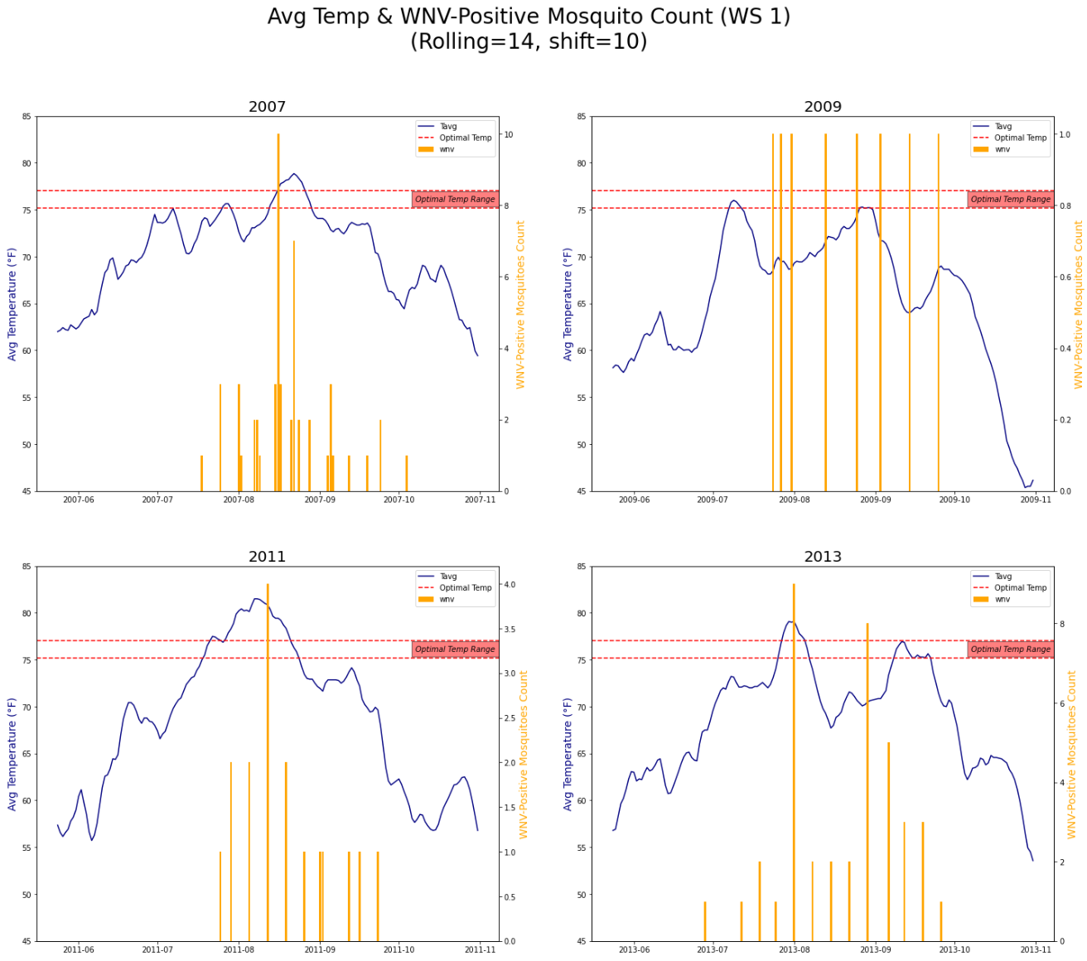
EDA: Temperature
Temperature has an impact on these 3 factors:
Mosquito reproduction rate
Mosquito biting rate
Virus replication rate
Optimal temperature for WNV to spread is between 75.2 to 77 degrees Fahrenheit
Higher temperatures have both an immediate and delayed impact on the WNV-positive mosquito count

Slide 14
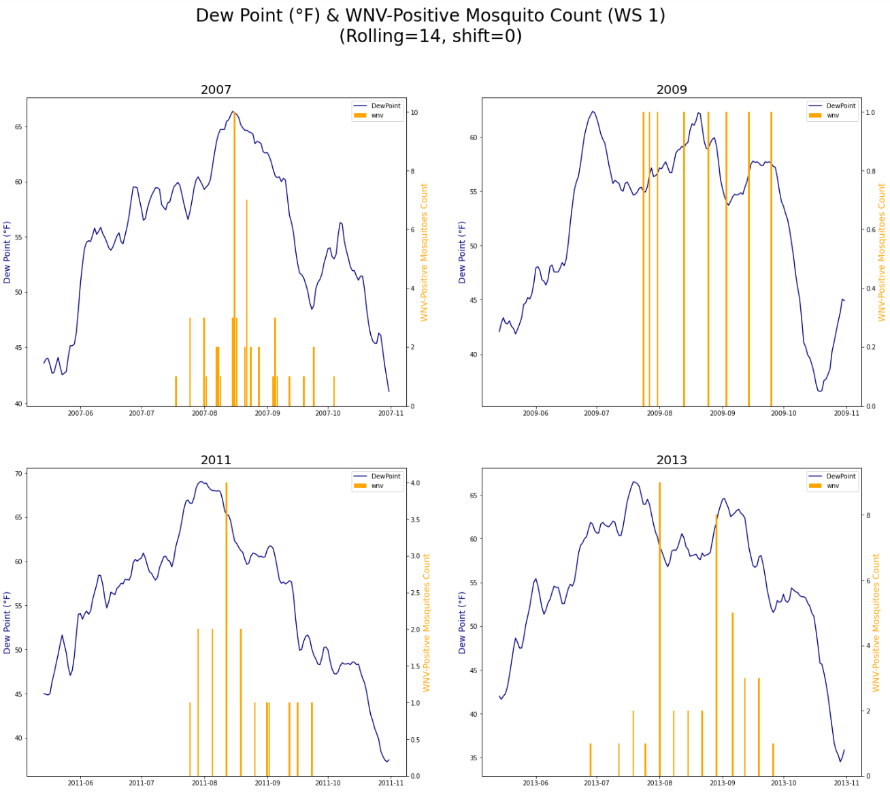
EDA: Dew Point
Dew point tends to peak between July and September
Generally, higher dew points do result in higher WNV counts

Slide 15
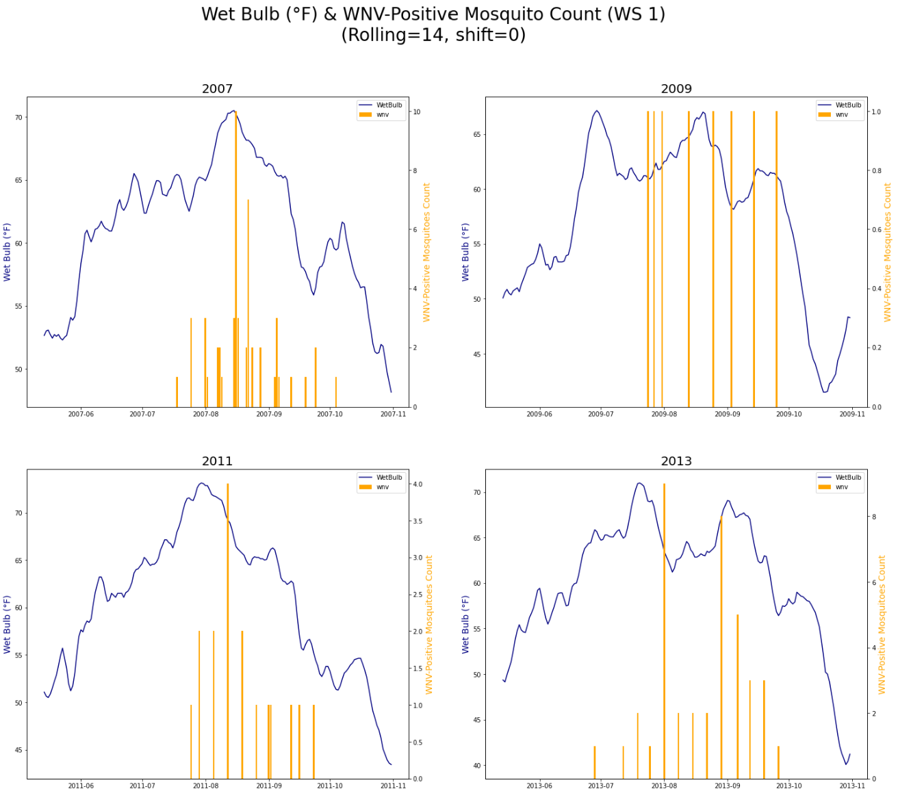
EDA: Wet Bulb
Wet bulb tends to peak between July and September
Generally, higher wet bulb temperatures are associated with higher levels of humidity, which offsets the higher temperatures, and thus results in higher WNV counts

Slide 16
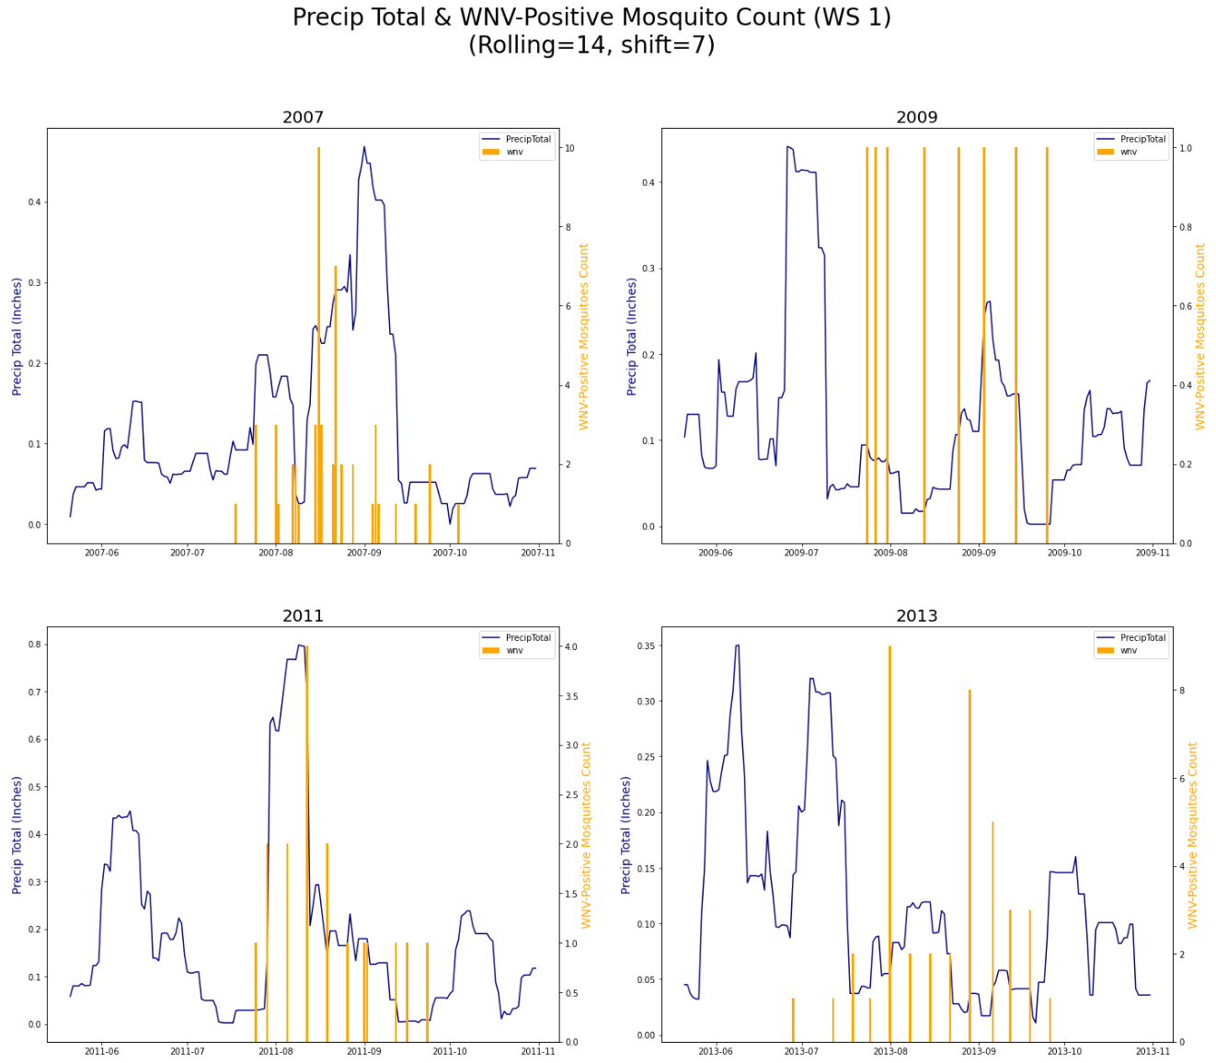
EDA: Precipitation
Higher precipitation increases the amount of water surfaces for mosquitoes to breed
This explains the spikes in WNV-positive counts after periods of heavy precipitation as shown in the years 2009, 2011 and 2013

Slide 17
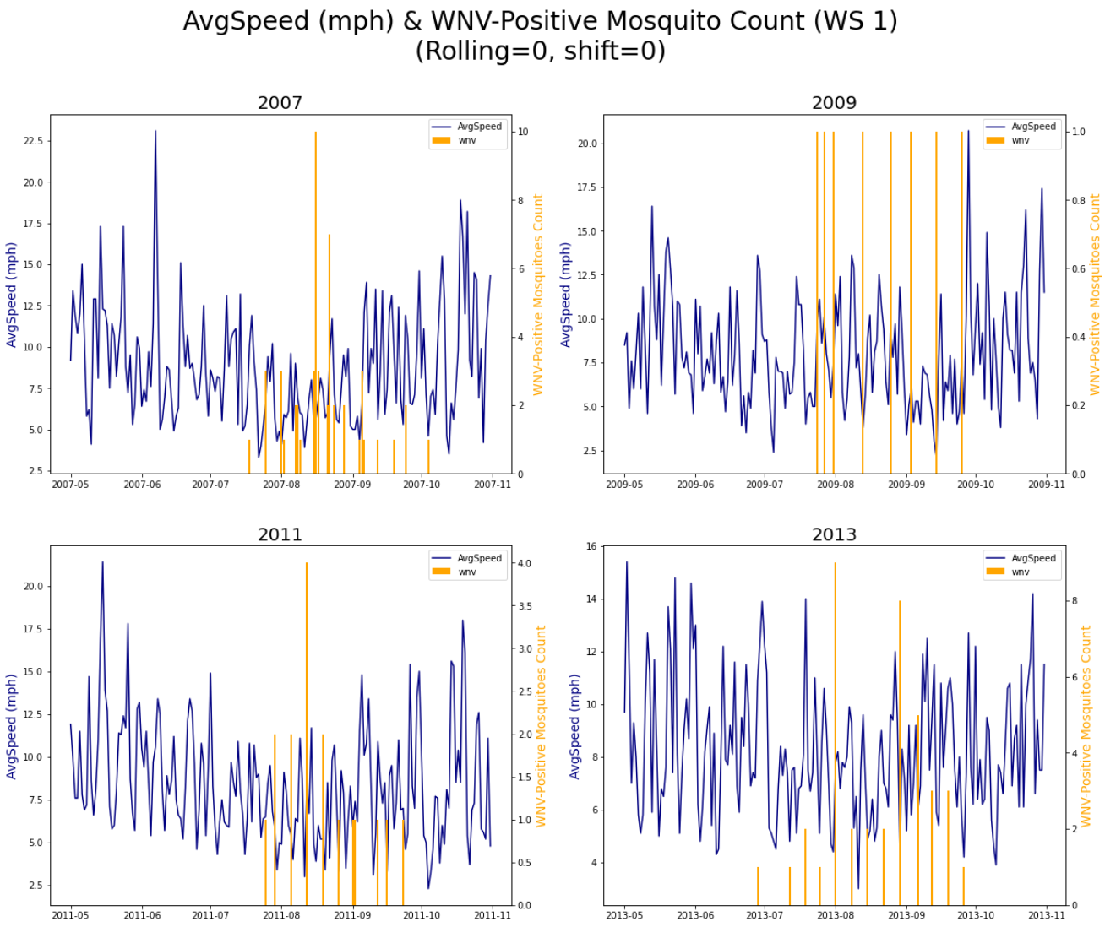
EDA: Wind
Lower average wind speeds show a larger number of WNV-positive mosquitoes being detected
It is likely that fewer mosquitoes are detected when wind speeds are higher, and they are only detected by traps during lower wind speeds

Slide 18
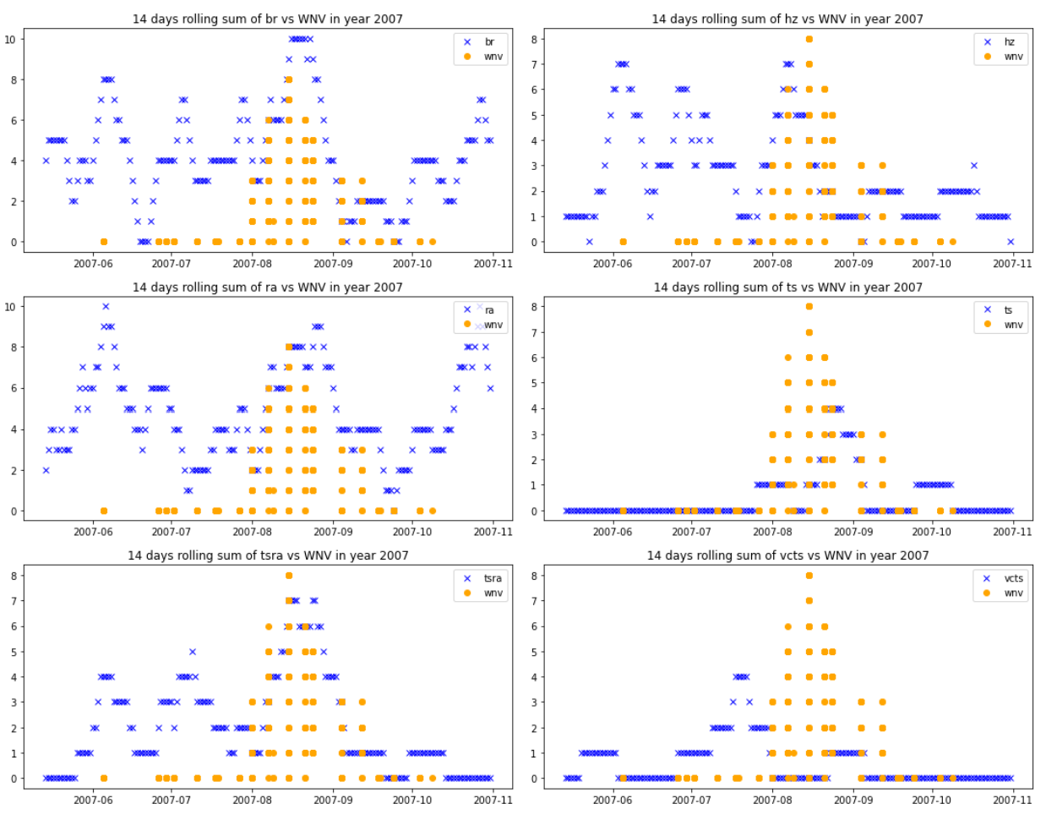
EDA: Weather Conditions
Weather conditions associated with rain (thunderstorm, thunderstorm / rain, vicinity thunderstorm, rain, mist, haze) were found to be most highly correlated to the presence of WNV

Slide 19
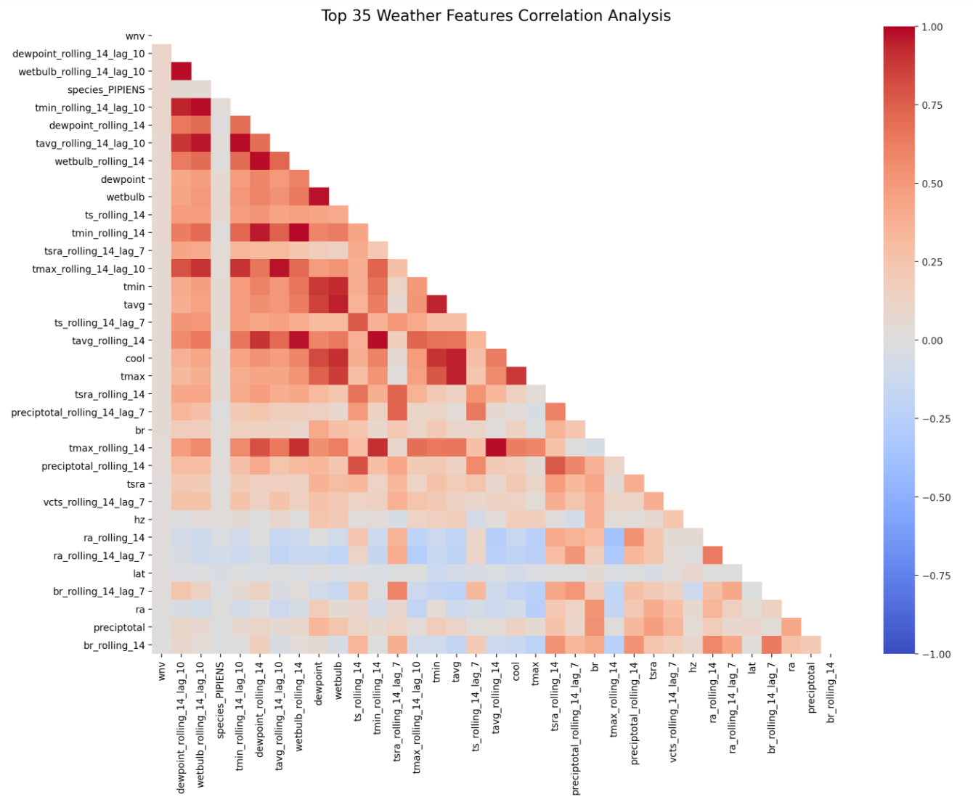
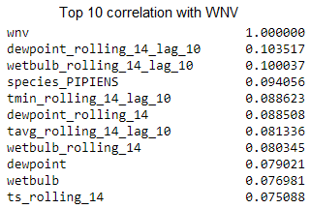
EDA: Top Features
Temperature-related features were the most correlated with one another
Rolling average and time lags increases the correlation between the weather features and the WNV

Slide 20
Modelling
Models Tested:
Logistic Regression
K-Nearest Neighbors
Random Forest
Extra Trees
Support Vector Machine
XGBoost

Slide 21
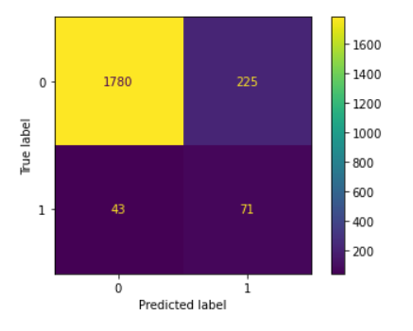
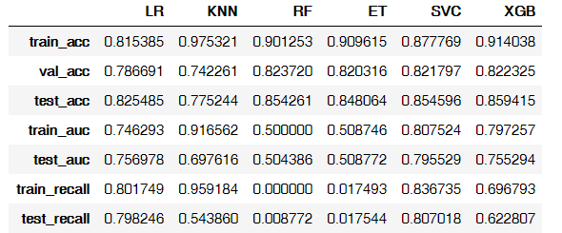
Modelling Results

Slide 22
Kaggle Submission Score
Using XGBoost with smote, our best parameters are:
{'sampling__k_neighbors': 5,
'xgb__alpha': 0.1,
'xgb__colsample_bytree': 0.9,
'xgb__gamma': 0.4,
'xgb__gpu_hist': 'gpu_hist',
'xgb__lambda': 0.2,
'xgb__learning_rate': 0.1,
'xgb__max_depth': 5,
'xgb__min_child_weight': 2,
'xgb__n_estimators': 100,
'xgb__n_jobs': -1,
'xgb__subsample': 0.8,
'xgb__verbosity': 2}
Kaggle Set
Kaggle Score:

Slide 23
Cost Benefit Analysis
Estimated Epidemic Cost:
Nationwide: $778 million over 15 years
Louisiana (2005): $20 million
Sacramento, California (2005): $2.98 million
Average cost per infected person: $18,000 - $61,000 (depending on severity)
Cost of spraying:
Vector Control Cost: $701, 790
15 prevented WNV cases would justify the cost
Notes:
According to research

Slide 24
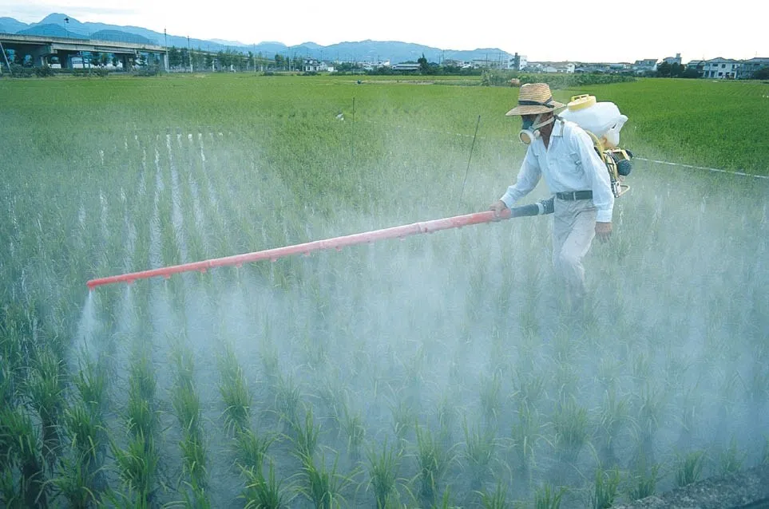
But is this enough?
Notes:
According to research

Slide 25
Cost Benefit Analysis
Optimise spraying for weather conditions and months:
Lower wind speeds (reduces spray drift)
Temperatures below 86°F (30°C)
Humidity above 45%
July to September
Notes:
According to research

Slide 26
Cost Benefit Analysis
Alternative Measures
Eliminate mosquito breeding grounds
Insect repellent
Long-sleeve shirts and long pants
Notes:
According to research

Slide 27
Conclusion / Recommendations
Pesticide spraying is not enough
Combination of spraying and alternative measures
Spray in the right weather conditions

Slide 28
THANK YOU

Slide 29
ABOUT THE DISEASE
Mercury
Mars
Jupiter
Saturn
Mercury is the closest planet to the Sun
Despite being red, Mars is actually a cold place
It’s the biggest planet in the Solar System
Saturn is composed of hydrogen and helium

Slide 30
ABOUT THE DISEASE
Mercury
02
Saturn
01
Jupiter
03
Mercury is the closest planet to the Sun
Saturn is composed of hydrogen and helium
It’s the biggest planet in the Solar System

Slide 31
ABOUT THE DISEASE
01
01
Mercury
02
Venus
02
04
03
Mars
04
Jupiter
03

Slide 32
CONCEPTS AND TYPOLOGY
Saturn
Neptune
Mars
Saturn is composed of hydrogen and helium
Neptune is the farthest planet from the Sun
Despite being red, Mars is actually a cold place

Slide 33
01
Section
You could enter a subtitle here if you need it

Slide 34
PATHOLOGY
Mercury is the closest planet to the Sun, but does its name have anything to do with the liquid metal?
Despite being red, Mars is a cold place. The planet is full of iron oxide dust
Jupiter is the biggest planet in the Solar System and the fourth-brightest object in the sky
Saturn is the ringed one. It’s a gas giant, composed mostly of hydrogen and helium

Slide 35
SYMPTOMS OF THE DISEASE
Saturn
Venus
Mars
Mercury
Saturn is composed of hydrogen and helium
Venus is the second planet from the Sun
Despite being red, Mars is a cold place
Mercury is the closest planet to the Sun

Slide 36
AWESOME WORDS

Slide 37
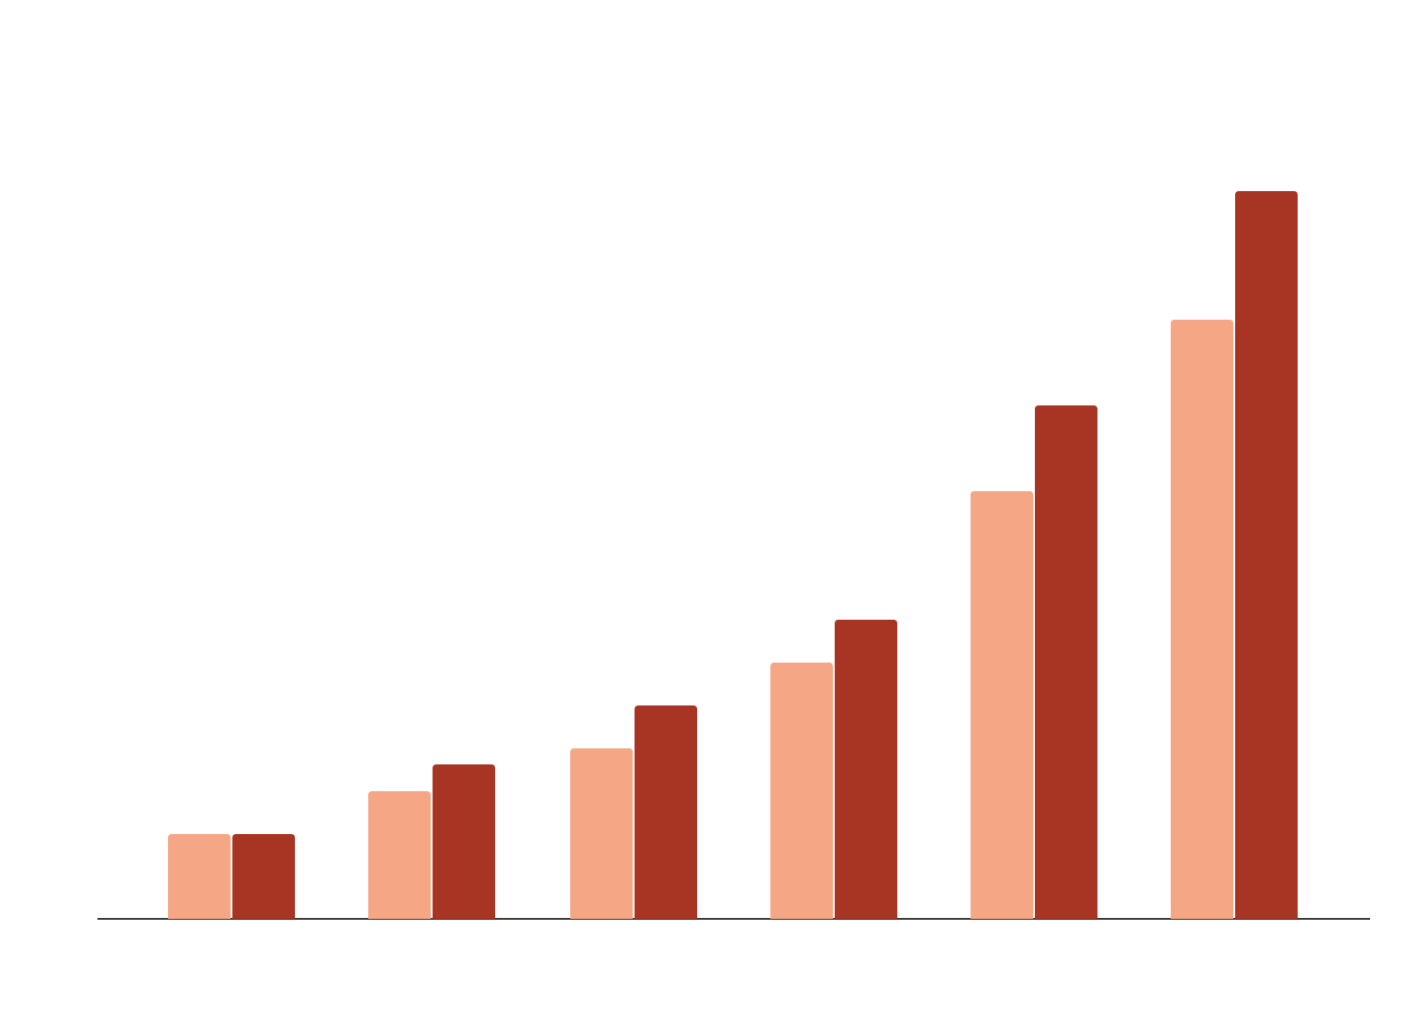
RISK FACTORS
Factors
Evolution
0-12 y/o
60+ y/o
Mercury
Mars
Venus
If you want to modify this graph, click on it, follow the link, change the data and paste the resulting graph here

Slide 38
50,000
10+
Cases detected
Countries affected

Slide 39
—SOMEONE FAMOUS
“This is a quote. Words full of wisdom that someone important said and can make the reader get inspired.”

Slide 40

A Picture Is Worth a Thousand Words

